Slide 1
OPEN TEXTBOOKS Access, Affordability, and Academic Success
Jonathan Lashley, ABD
Boise State University
By David Ernst. This work is licensed under the Creative Commons Attribution 4.0 International License.

Slide 2
“…higher education shall be equally accessible to all”
Notes:
Not that many people know that United Nations’ Universal Declaration of Human Rights actually has language embedded within it concerning the importance of equal access to higher education (A26).
You might think of those people around the world. But no we are also talking about here in this country, where people who do not have equal access to higher ed.
And we are talking about an issue that is much broader than just textbooks.
I am very pleased to be here and to have a chance to speak with you about issues that I think concern us all. When I think about the value and goals of higher education, I see a vehicle to unleash human potential, to help our students become both knowledgeable & skillful, to become good global and good local citizens. I see a vehicle that has the potential to deliver us from social inequality. However, I also see that far too often higher education is structured in a way that only serves to reinforce social inequality.

Slide 3
The cost barrier kept
2.4 million
low and moderate-income college-qualified high school graduates from completing college in the previous decade.
The Advisory Committee on Student Financial Assistance http://files.eric.ed.gov/fulltext/ED529499.pdf
Notes:
This is from a study done for the US Department of Education. 2.4 million did not finish college because of cost in the first decade of this century.

Slide 4
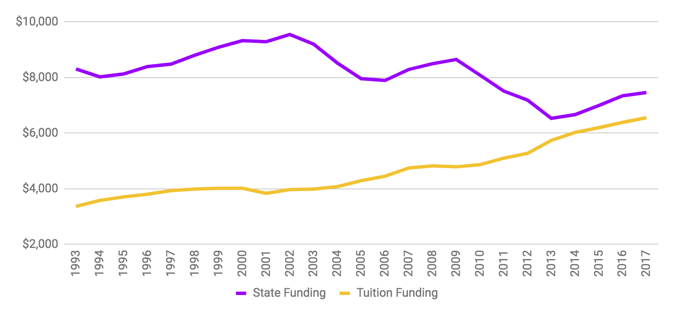
Higher Education Funding - US
http://www.sheeo.org
Notes:
Compare the proportion of cost that students must contribute in 1989 to today.

Slide 5
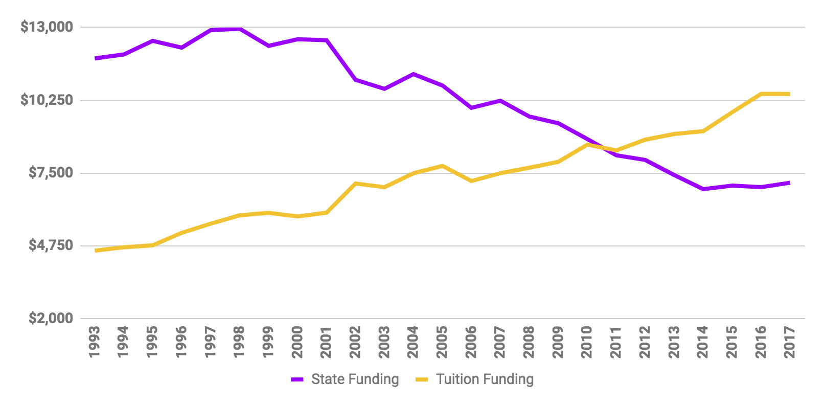
Higher Education Funding - New Jersey
http://www.sheeo.org
Notes:
Compare the proportion of cost that students must contribute in 1989 to today.

Slide 6
The average borrower owes more than
$28,650
in student loans (class of 2017).
http://ticas.org/posd/map-state-data
Notes:
About 2/3 of students borrow to get through school. These borrows graduate with an average debt of …
National data:https://ticas.org/content/pub/student-debt-and-class-2017
Include state/institution’s data – can be found at https://ticas.org/posd/map-state-data#overlay=posd/state_data/2018/in

Slide 7
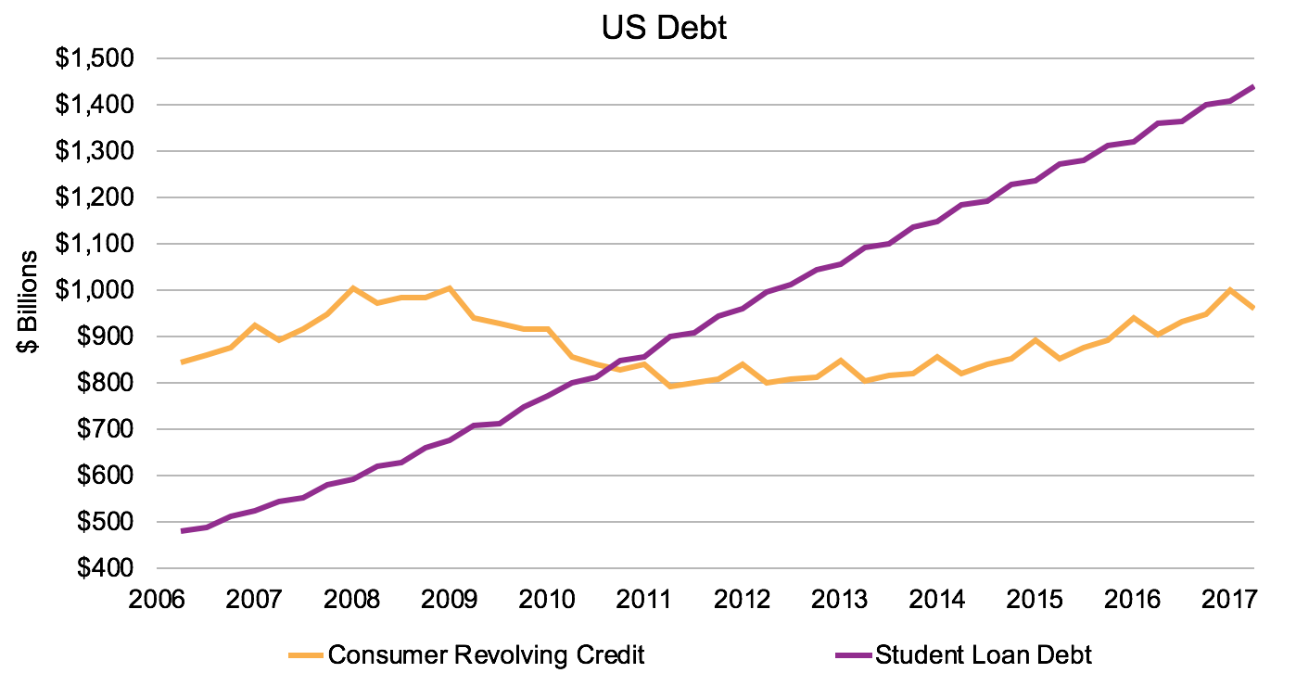
Federal Reserve http://www.federalreserve.gov/releases/g19/Current/
Notes:
Consumer Revolving Credit = Credit Card Debt
Tripled in just a decade, over 1.4 Trillion

Slide 8
Notes:
http://www.ocregister.com/2017/09/29/starving-students-no-longer-a-laughing-matter-as-free-college-food-pantries-spread/

Slide 9
https://sites.temple.edu/cufba/
Notes:
The College and University Foodbank Alliance started in 2012 with 13 members.
As of June, 2018, they had 641 members.

Slide 10
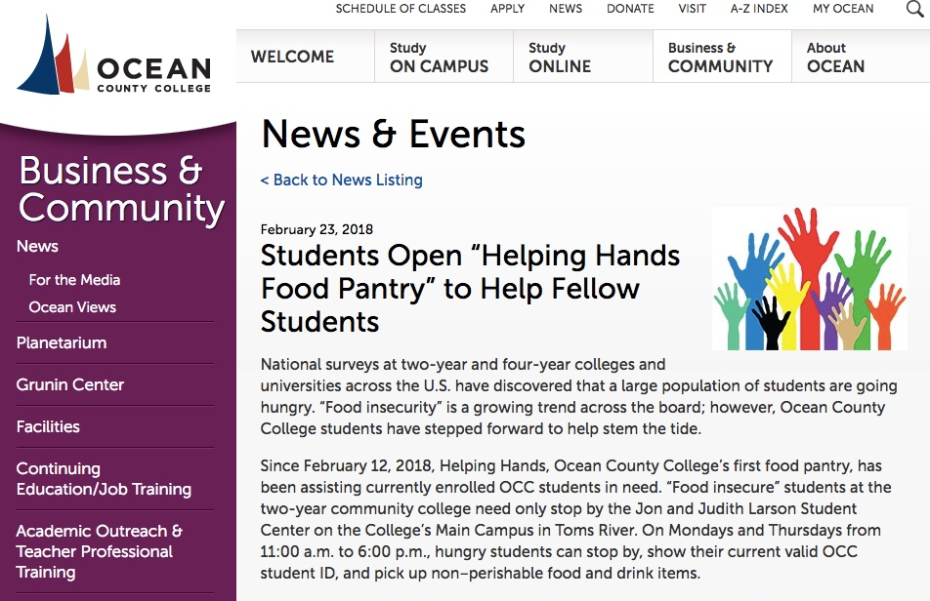
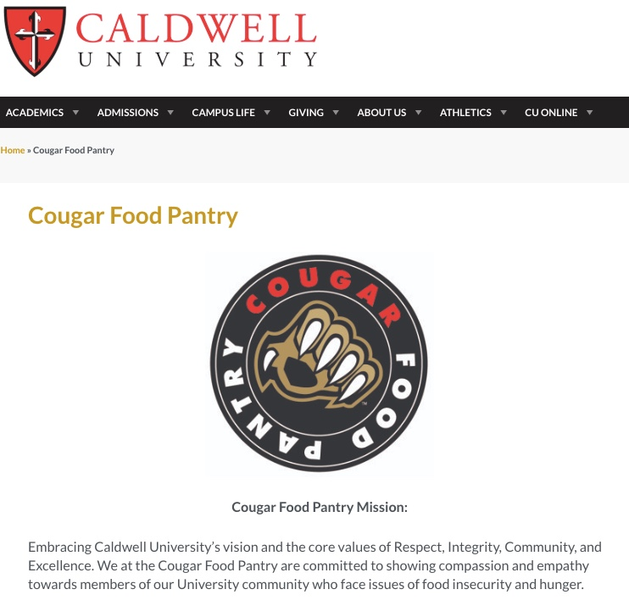
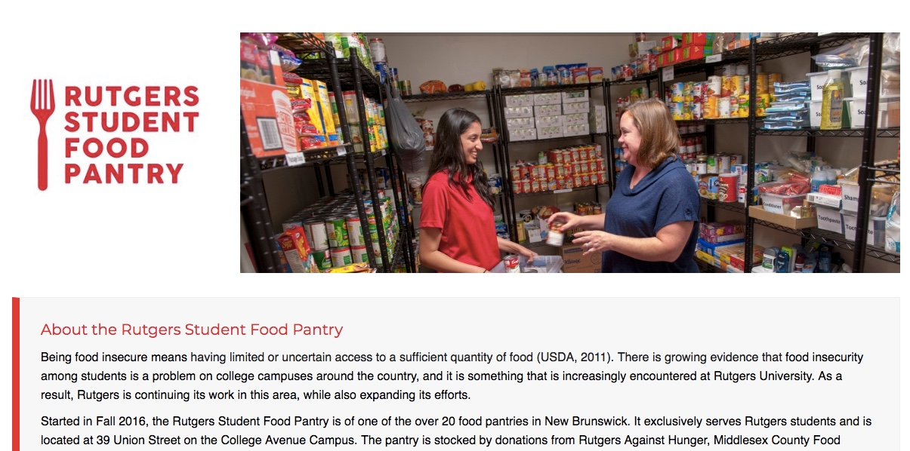
https://www.caldwell.edu/cougar-food-pantry
https://legacy.ocean.edu/content/public/for-the-community/news/food-pantry.html
http://ruoffcampus.rutgers.edu/food/

Slide 11
What can we do?
Tuition and Fees
Room and Board
Books and Supplies
Personal Expenses
Transportation
Notes:
Admit that it’s not the highest cost leading to these affordability issues – but it is:
the one cost that we as faculty can impact
it has a special impact on the academic success of students (as we’ll see later)

Slide 12
What can we do?
Tuition and Fees
Room and Board
Books and Supplies
Personal Expenses
Transportation
Notes:
Admit that it’s not the highest cost leading to these affordability issues – but it is:
the one cost that we as faculty can impact
it has a special impact on the academic success of students (as we’ll see later)

Slide 13
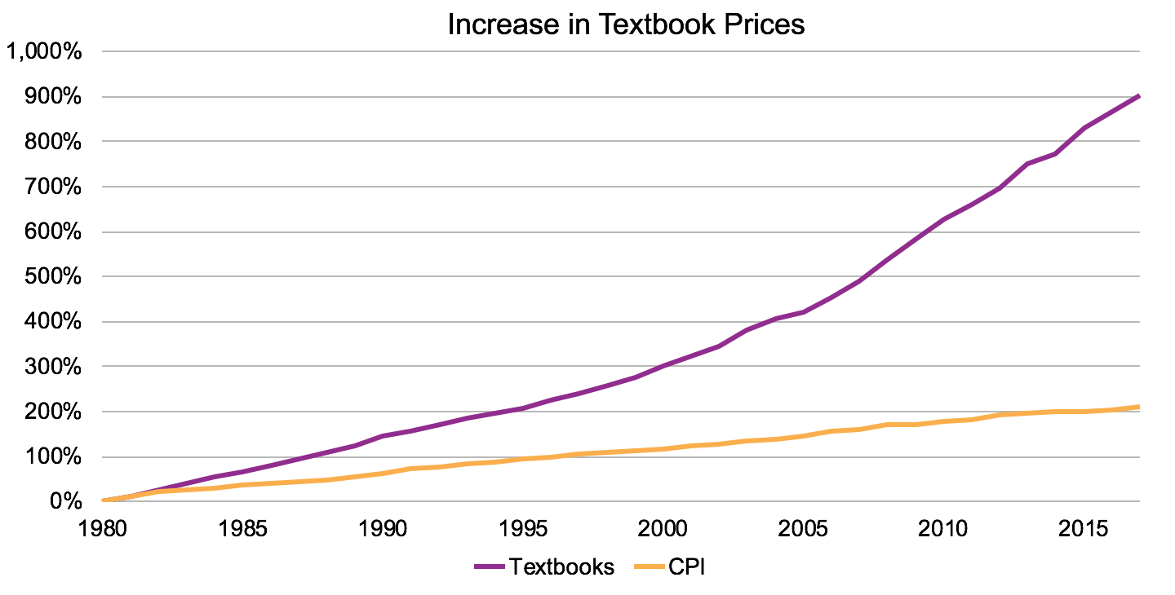
Bureau of Labor Statistics http://www.bls.gov/cpi/

Slide 14
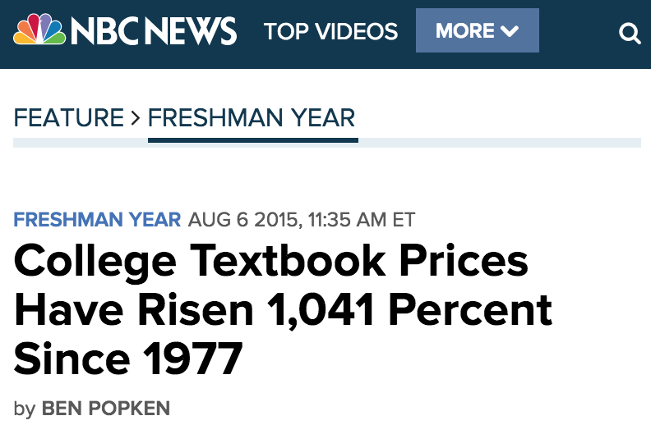
http://www.nbcnews.com/feature/freshman-year/college-textbook-prices-have-risen-812-percent-1978-n399926
Notes:
“[Textbook prices] have all been going up at a much faster rate than any other consumer product,” said Mark Perry, a finance and business economics professor at the University of Michigan-Flint.

Slide 15
The average student should budget
$1,240 - $1,440
for textbooks and course materials in 2018-19.
VALE = $1,471
https://trends.collegeboard.org/college-pricing/figures-tables/average-estimated-undergraduate-budgets-2018-19
Notes:
To get the institution’s estimate – Google “[name of institution] cost of attendance” and find the “books and supplies” category.

Slide 16
VALE
$1,900 Atlantic Cape $1,400 Bergen CC $0 Berkeley C $1,300 Bloomfield C $1,500 Brookdale CC $2,100 Caldwell U $1,800 Camden CC $1,300 C of St. Elizabeth $1,400 County C of Morris $1,920 Cumberland CC $1,200 Drew U $1,350 Georgian Court | $1,500 Hudson County CC $1,384 Kean U $1,390 Mercer County CC $1,390 Middlesex County C $1,038 Monmouth U $1,300 Montclair State $1,000 New Brunswick TS $1,200 NJ City U $2,600 NJ Institute of Tech $2,080 Ocean County C $1,600 Passaic County CC $1,569 Ramapo C | $2,400 Raritan Valley CC $1,500 Rider U $1,200 Rowan @ Burlington $1,600 Rowan @ Gloucester $1,600 Rowan U $1,350 Rutgers U $1,000 Saint Peter’s U $1,000 Seton Hall U $1,597 Stockton U $1,481 Sussex County $1,200 The C of NJ $1,700 Thomas Edison SU $1,600 William Paterson U
https://www.nbts.edu/admissions-financial-aid/tuition-form/cost-of-attendance/

Slide 17
What do you think about the cost of textbooks?
Notes:
It’s important to have the voice of students in the room.

Slide 18
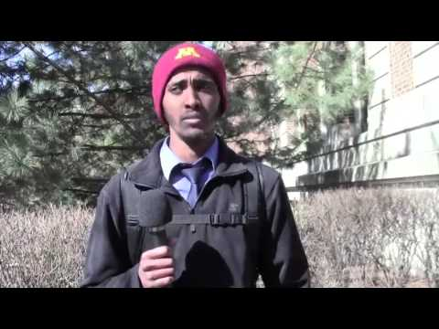
https://www.youtube.com/watch?v=0d6HTN6llgo
Notes:
https://www.youtube.com/watch?v=0d6HTN6llgo

Slide 19
Coping with the Cost
Purchase an older edition of the textbook
Delay purchasing the textbook
Never purchase the textbook
Share the textbook with other students
Download textbooks from the internet
Notes:
This section explores the ways students cope with the high costs and the academic risk, and the academic impact that those actions have.

Slide 20
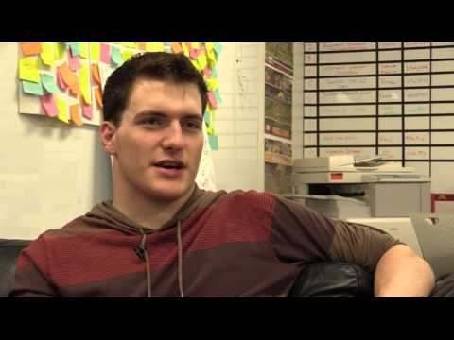
https://www.youtube.com/watch?v=-4IswNs0WWE

Slide 21
In your academic career, has the cost of required textbooks caused you to:
2012 | 2016
63.6% | 66.5% | Not purchase the required textbook
49.2% | 47.6% | Take fewer courses
45.1% | 45.5% | Not register for a specific course
33.9% | 37.6% | Earn a poor grade
26.7% | 26.1% | Drop a course
17.0% | 19.8% | Fail a course
http://www.openaccesstextbooks.org/pdf/2012_Florida_Student_Textbook_Survey.pdf
Notes:
This slide is the key slide in making the point that cost is having an academic impact.

Slide 22
Notes:
Ask them if they’re depressed yet. ☺ This is the end of defining the problem.
I typically ask what would solve this problem – what would make all the percentages on slide 22 go to 0%? Eventually, someone will say “free textbooks”. Ask the question “but how could a textbook be free? They typically cost hundreds of thousands of dollars to create.” Let’s look at a simplified explanation of the business model…

Slide 23
In your academic career, has the cost of required textbooks caused you to:
2012 | 2016
63.6% | 66.5% | Not purchase the required textbook
49.2% | 47.6% | Take fewer courses
45.1% | 45.5% | Not register for a specific course
33.9% | 37.6% | Earn a poor grade
26.7% | 26.1% | Drop a course
17.0% | 19.8% | Fail a course
http://www.openaccesstextbooks.org/pdf/2012_Florida_Student_Textbook_Survey.pdf
Notes:
This slide is the key slide in making the point that cost is having an academic impact.

Slide 24
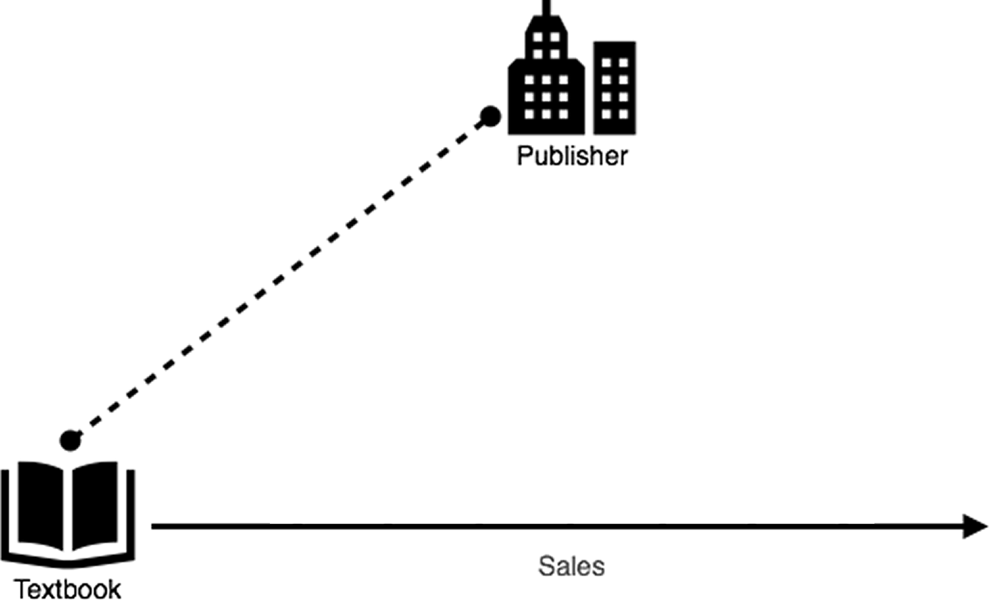
Notes:
Publishers invest in creating a textbook…

Slide 25
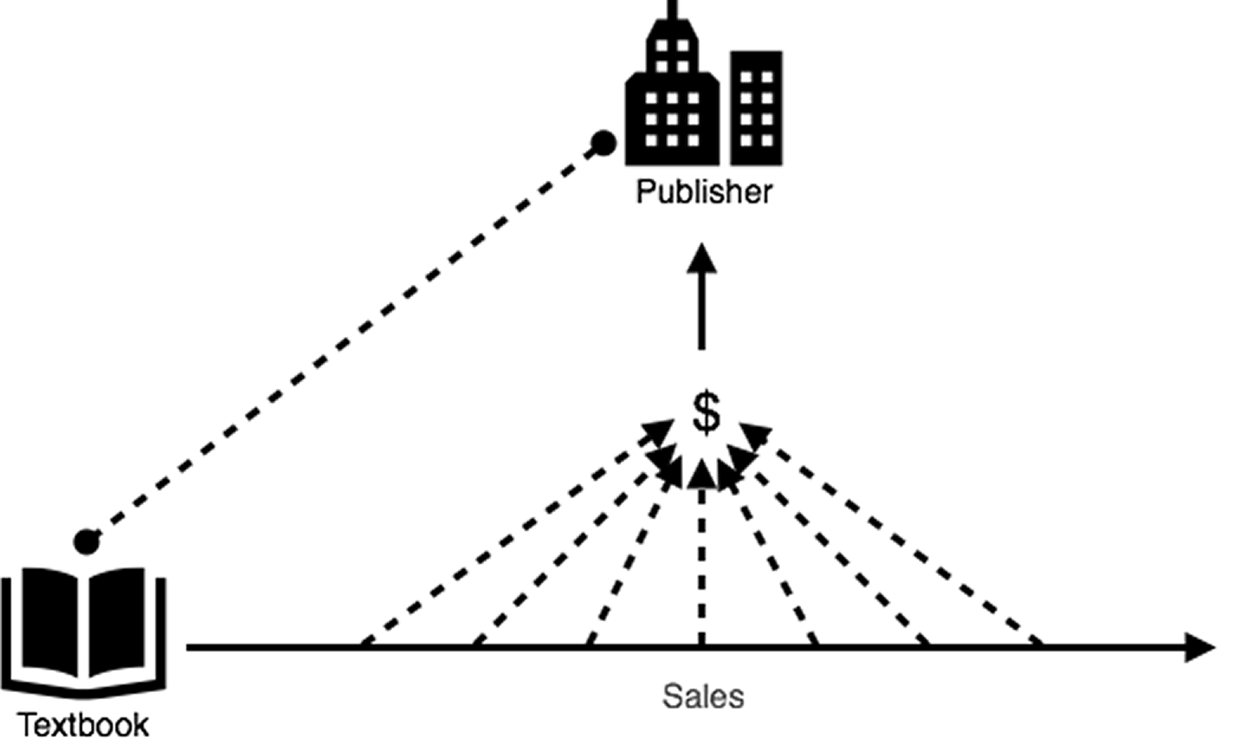
Notes:
…they recoup their investment (and make a profit) through sales of the books...

Slide 26
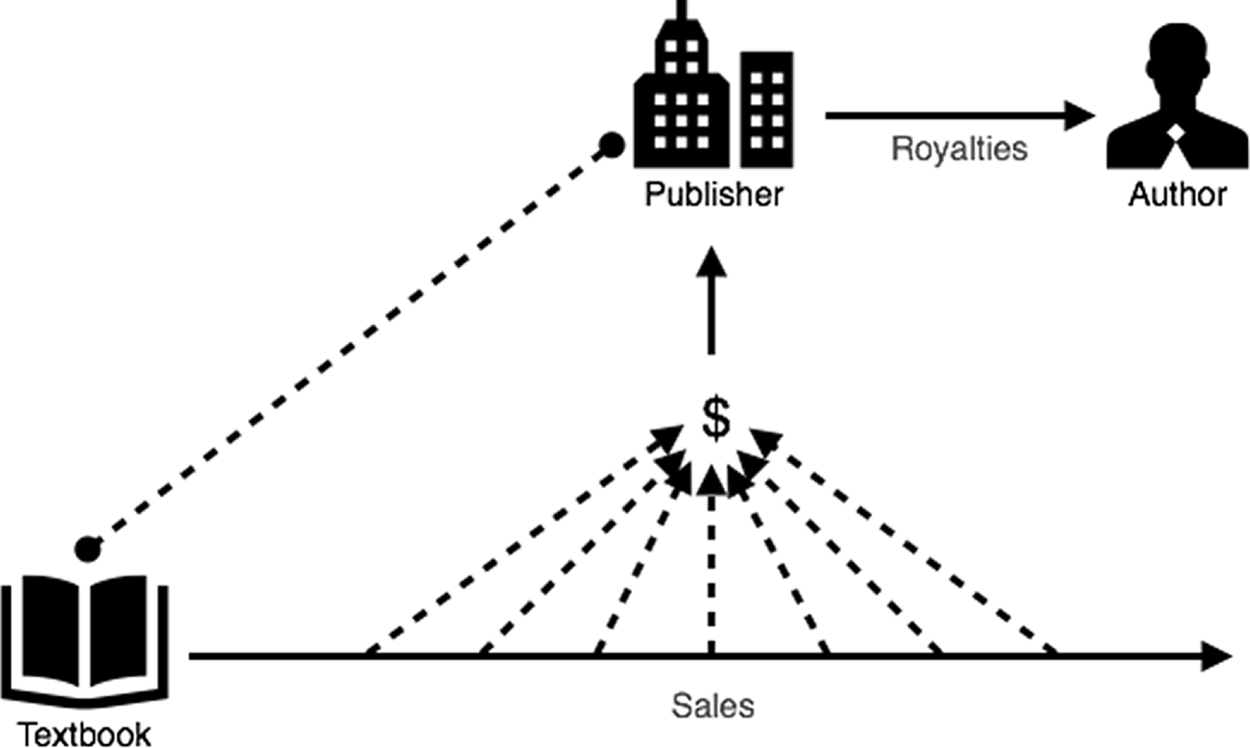
Notes:
…and have money to pay royalties to authors – typically 5% - 12%. So, if a book is free (there aren’t any sales), how could this possibly work?

Slide 27
Notes:
…and have money to pay royalties to authors – typically 5% - 12%. So, if a book is free (there aren’t any sales), how could this possibly work?

Slide 28
Other models…
Notes:
Two other models…

Slide 29
Notes:
Model 1: Someone writes a book, usually for their own course, and puts it on the internet for others to use. This is not the most prevalent, nor is it where the activity is right now…
Admit that these books might not be peer reviewed in the traditional sense.

Slide 30
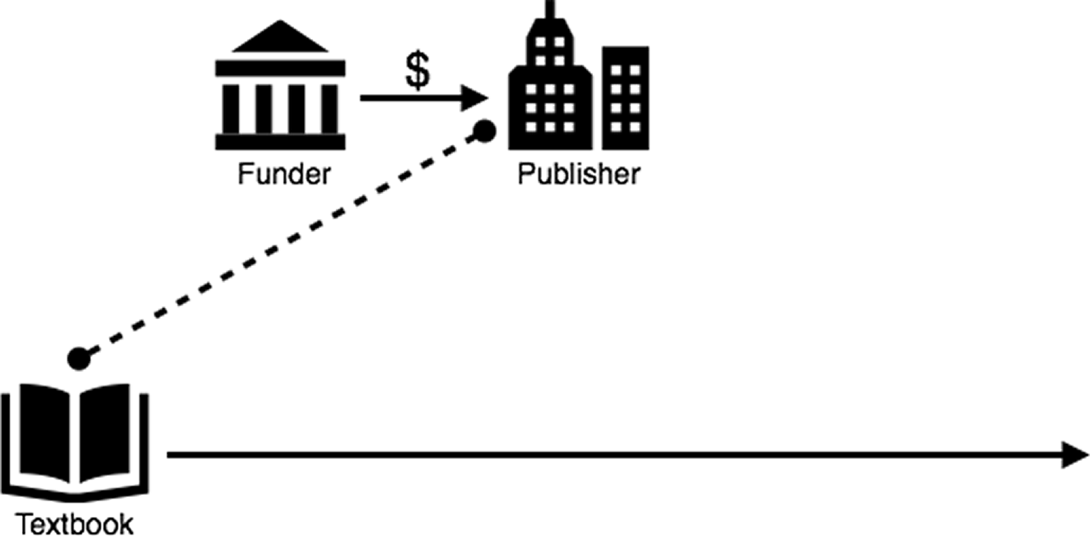
Notes:
Model 2: The addition of a “funder”. The funder agrees to pay for production of the book, but with one stipulation: The book needs to be free forever. The publishing process could be exactly the same…

Slide 31
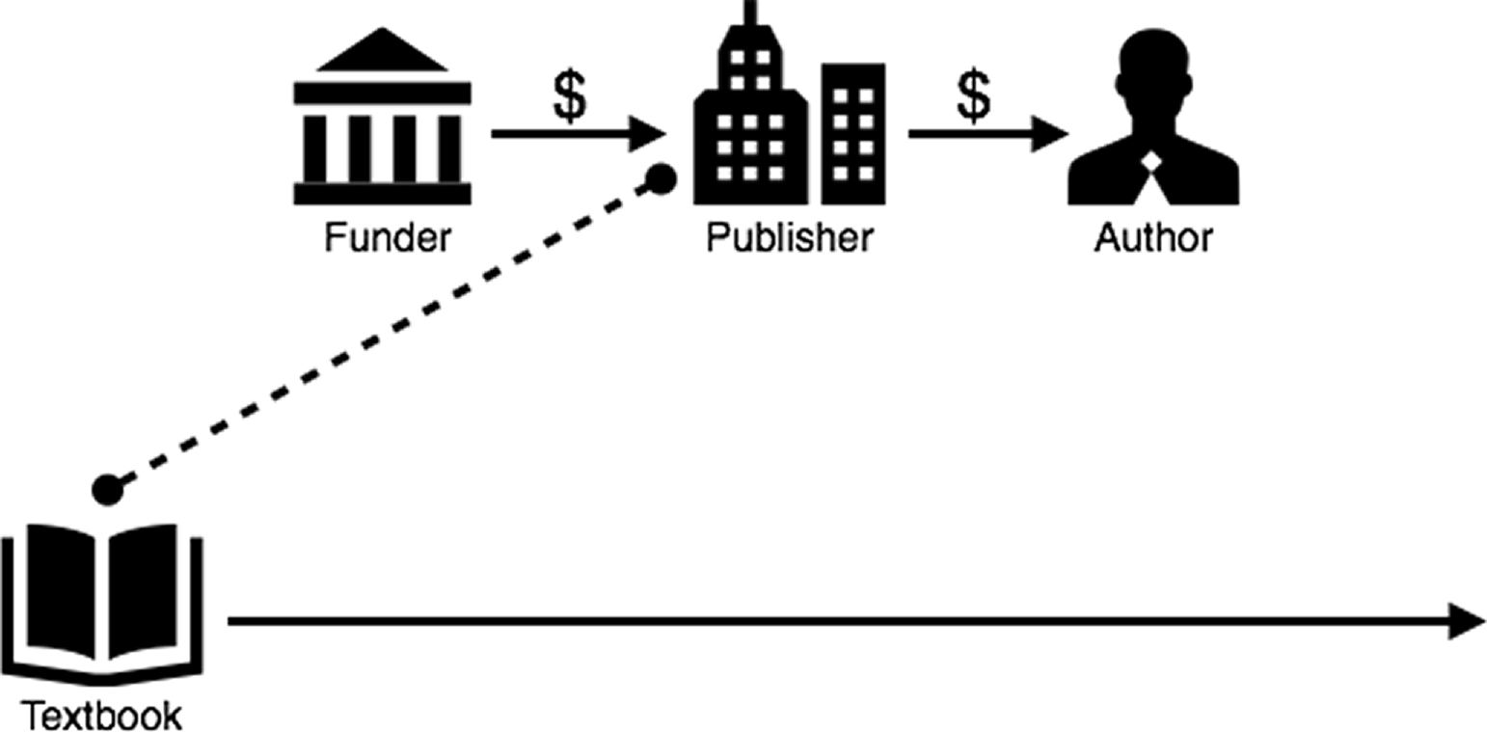
Notes:
…the author can even get paid.

Slide 32
Where does the funding come from?
Universities (SUNY, Umass Amherst, Portland State, …)
Foundations (Hewlett, Gates, …)
Governments (state, federal)
Institutional Consortia (CALI)
Notes:
Where does this funding come from?

Slide 33
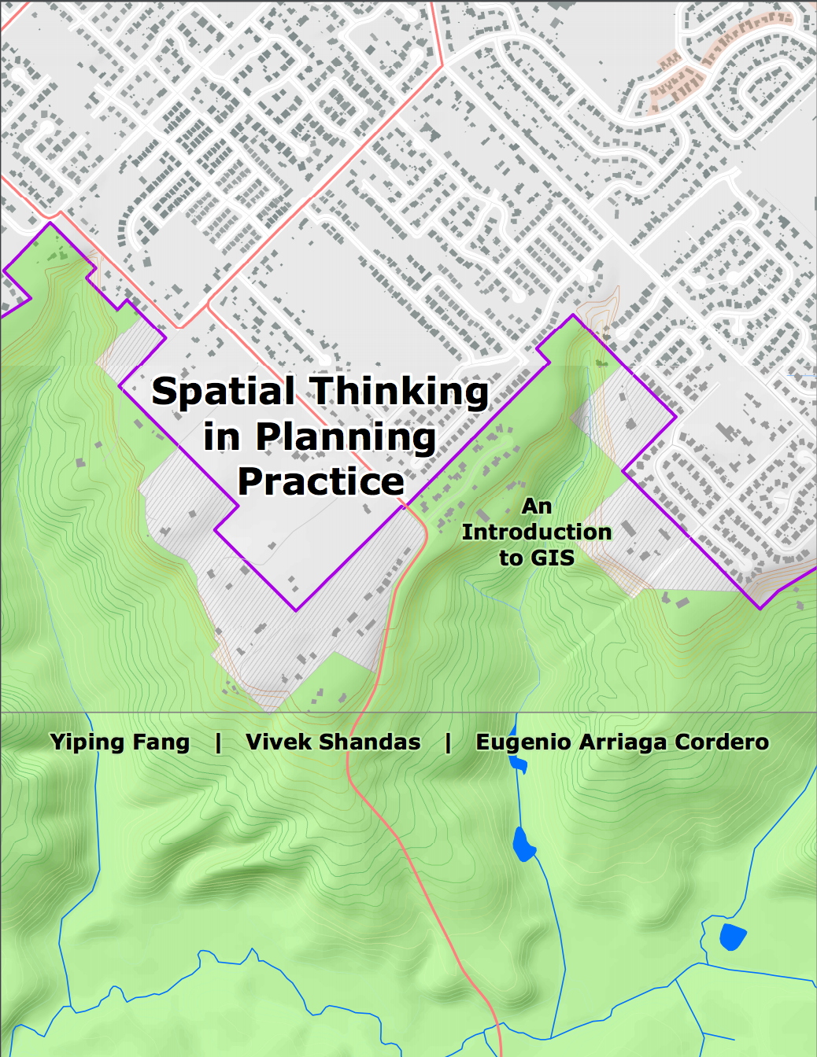
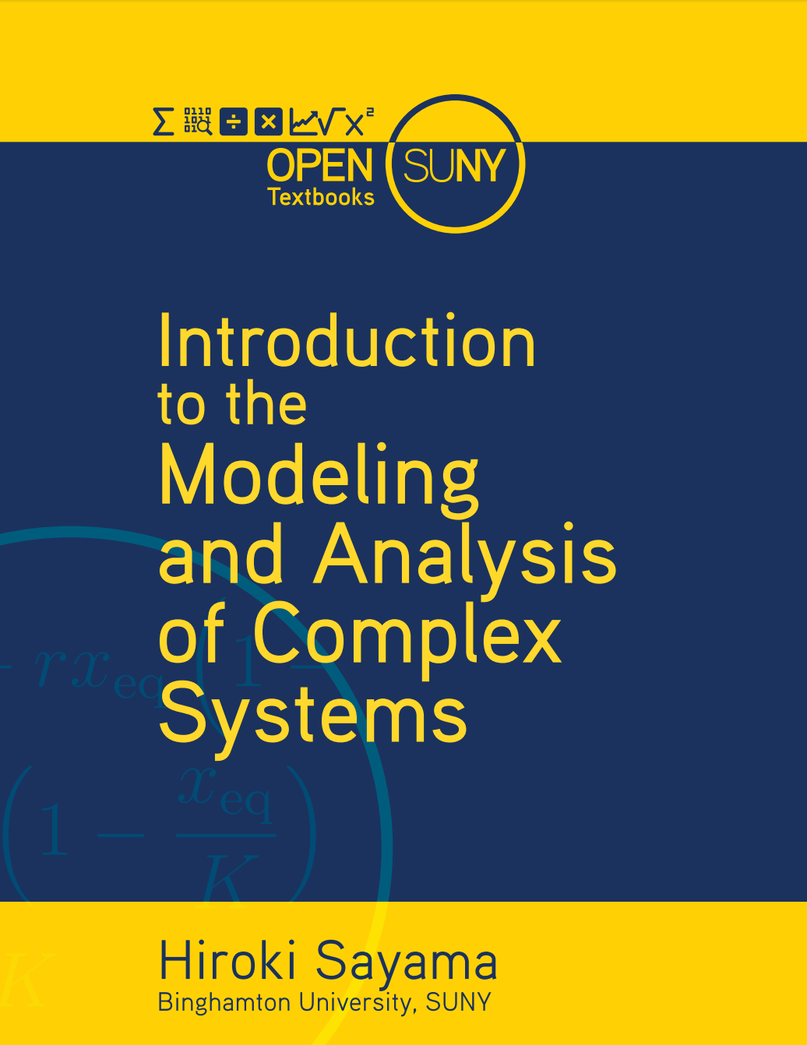
Notes:
Some example books from (1) Portland State University, and (2) SUNY – funded by the institutions

Slide 34
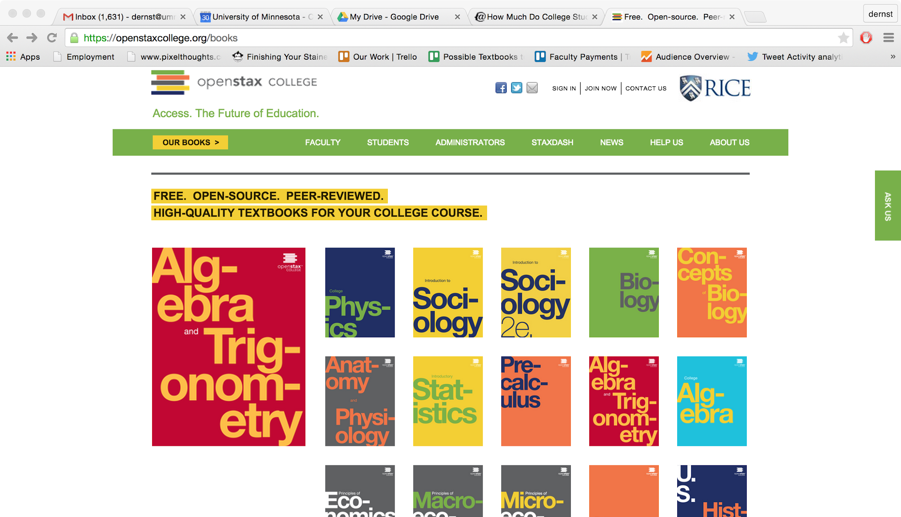
Notes:
OpenStax (Rice University) – funded by foundations

Slide 35
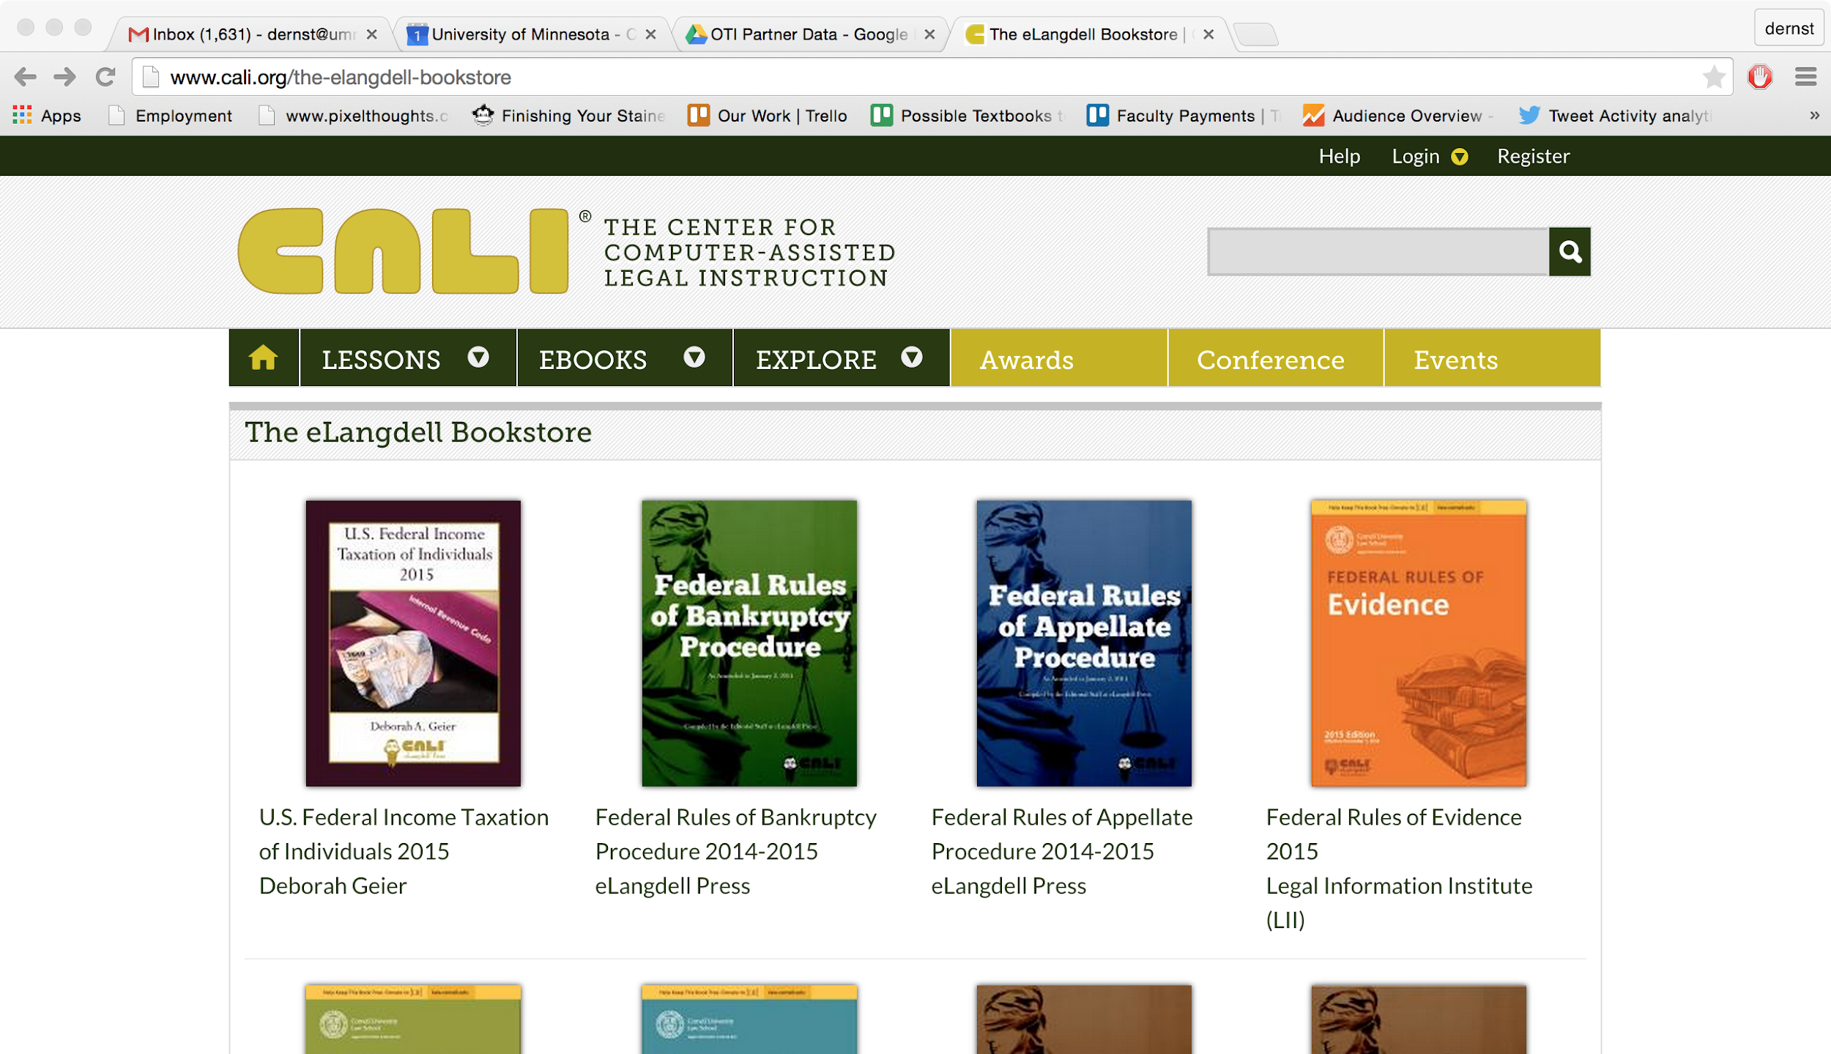
Notes:
CALI is funded by “just about every law school in the country” and they update these books annually. – funded by members.

Slide 36
Notes:
There’s just one thing missing…
How does the end user – the faculty and students – know the intent of the funder and publisher? Can they just give these books away for free? What about copyright?

Slide 37
Higher Education
Notes:
There’s just one thing missing…
How does the end user – the faculty and students – know the intent of the funder and publisher? Can they just give these books away for free? What about copyright?

Slide 38
Higher Education
Notes:
There’s just one thing missing…
How does the end user – the faculty and students – know the intent of the funder and publisher? Can they just give these books away for free? What about copyright?

Slide 39
Notes:
Acknowledge that copyright law is extremely important. Then note that it wasn’t intended to help people who want to share. So it isn’t sufficient in this case. We need …

Slide 40
Notes:
… the Creative Commons. The CC is a nonprofit that created licenses to help people who want to share intellectual proerty.

Slide 41
All Rights
Reserved
Some Rights
Reserved

Slide 43
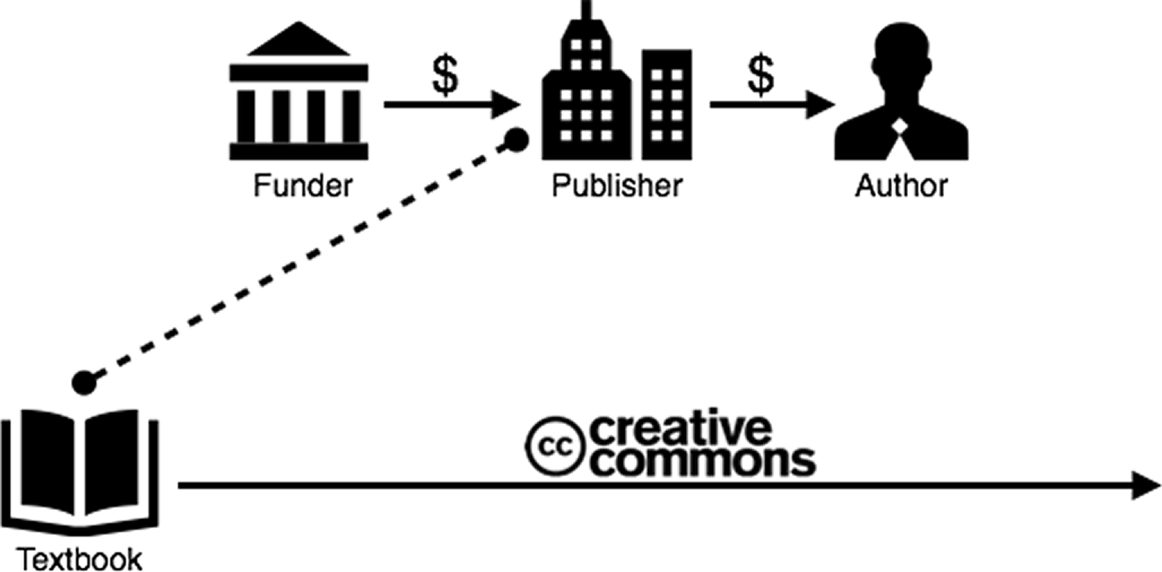
Higher Education
Notes:
So, the CC license is the last piece to this model. Now the end user knows what the intent of the funder/publisher is.

Slide 44
With Creative Commons licenses, you are free to…
Copy | Mix
Share | Keep
Edit | Use
Notes:
The licenses allow for these things…

Slide 45
Notes:
…give a brief overview of the four license components.

Slide 46
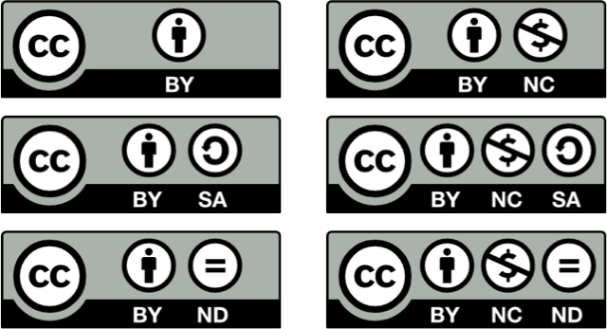
Notes:
These are the 6 CC licenses. Maybe even quiz them on one or two...
Note that these licenses are used in many places, but we often don’t notice...

Slide 47
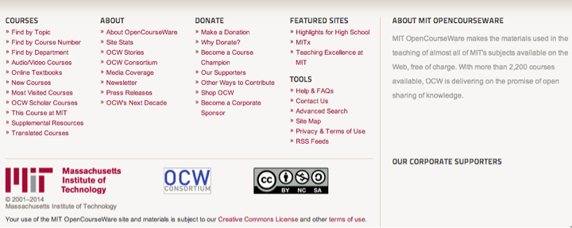
Notes:
MIT Open Courseware
This is a screenshot from an OCW page – there was a video above. Note the license.
MIT wants you to use it, and here are their terms: (BY NC SA). Ask what that means.

Slide 48
Notes:
TED Talks: BY NC ND
Ask what that means.

Slide 49
How can CC help open textbooks improve student success?

Slide 50
Content Customization
Localization
OER Enabled Pedagogy

Slide 51
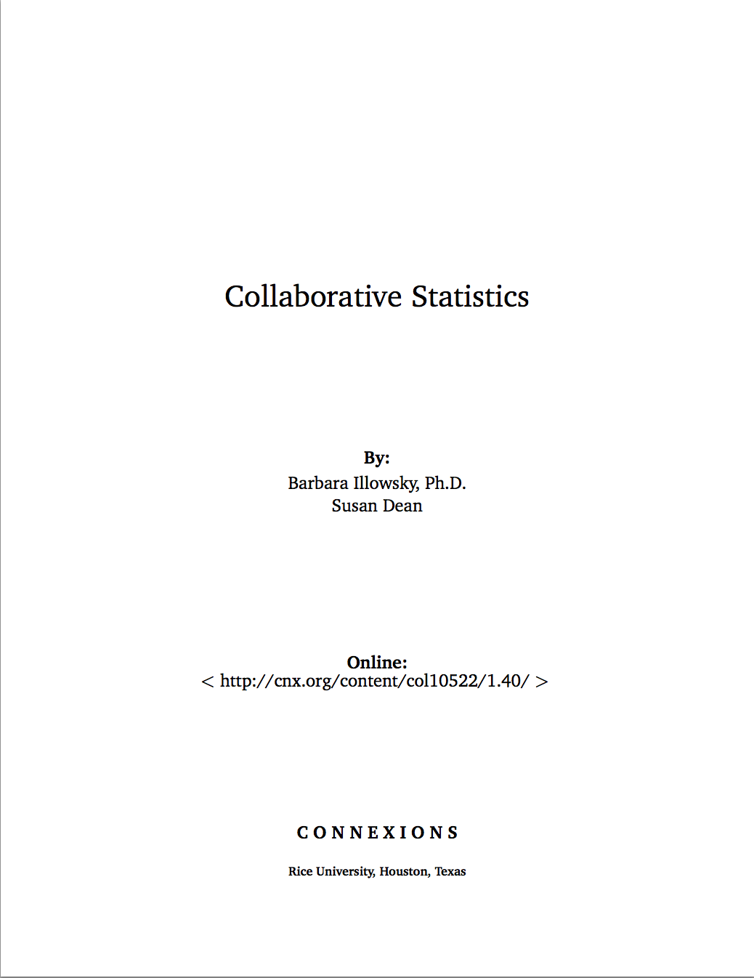
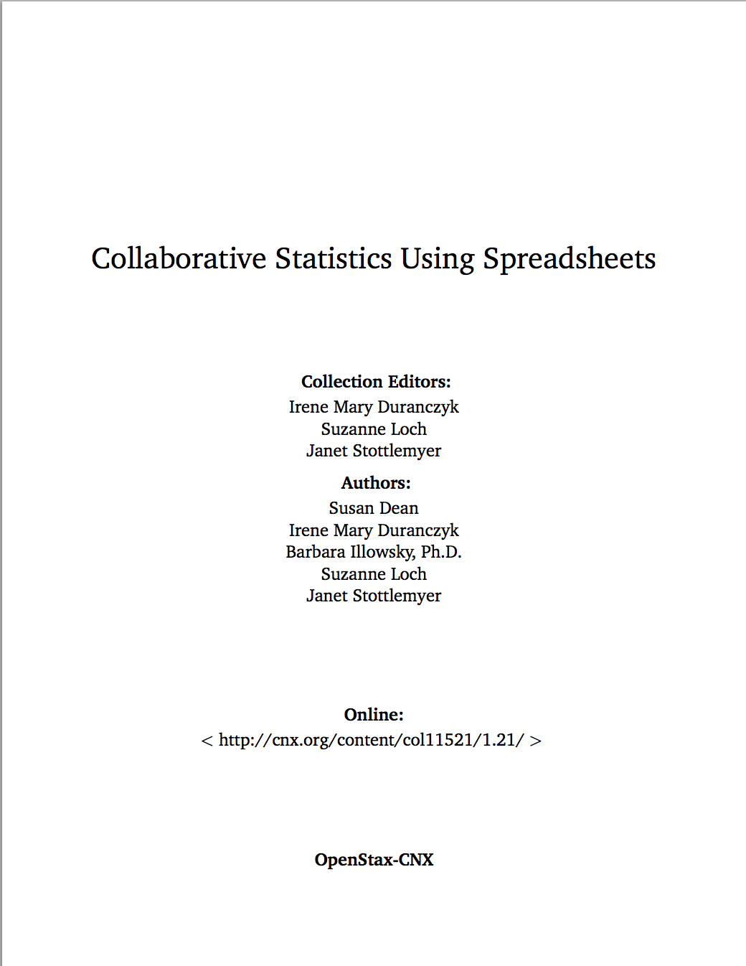
Content Customization

Slide 52
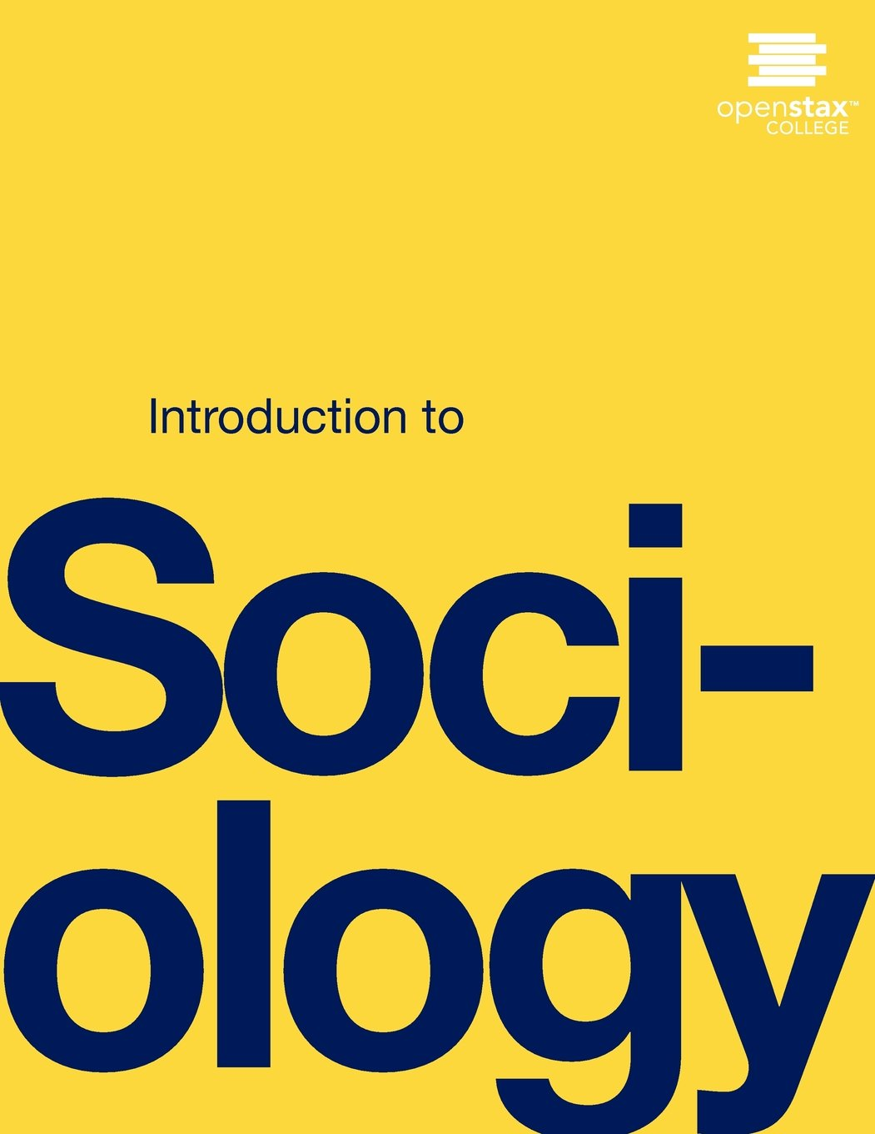
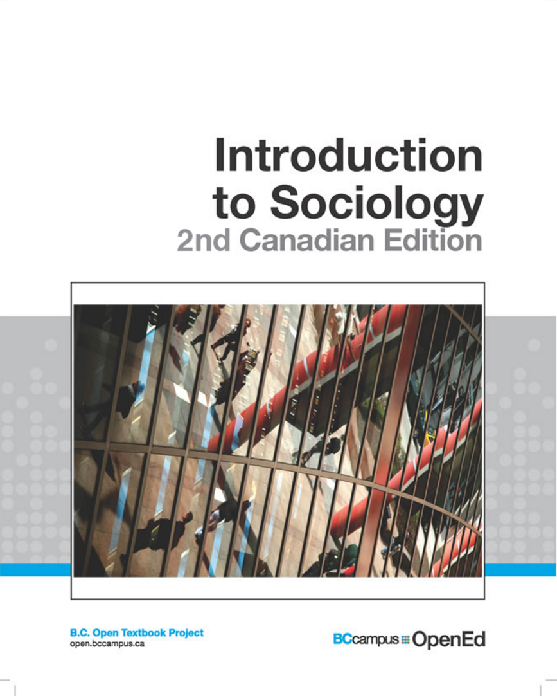
Localization

Slide 53
Localization

Slide 54
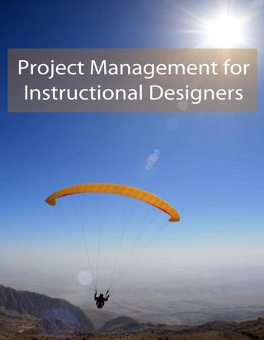
OER Enabled Pedagogy
https://pm4id.org/

Slide 55
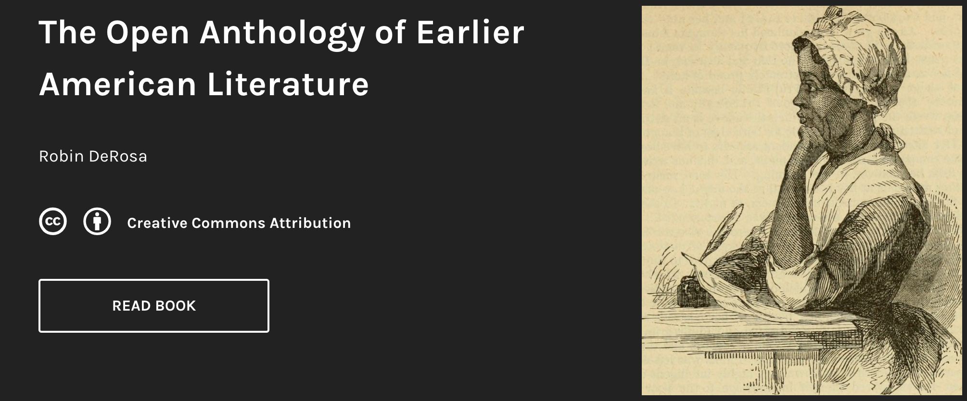
OER Enabled Pedagogy
https://openamlit.pressbooks.com/

Slide 56
Introductory, algebra-based, two-semester college physics
1272 pages
Available in
PDF
ePub
Print
Web
Bookshare (accessible)
Instructor solution manual
Powerpoint slides
Notes:
So, an open textbook (possibly the first time the term “open textbook” is used) is a textbook with a CC license – it’s free and you can do all the things on slide 43.
Here’s an example. Note the ancillary materials. Note that they shouldn’t assume that an open textbook doesn’t have them – some do and some don’t (just like commercial textbooks)

Slide 57
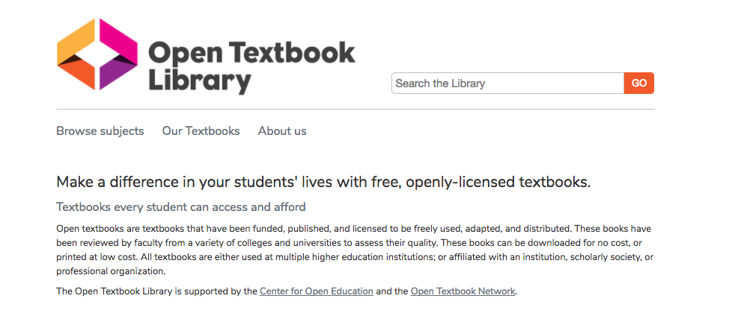
open.umn.edu
Notes:
This section is about credibility. The OTL is a collection of open textbooks to make it easy to find them, but we also are asking faculty to write reviews…

Slide 58
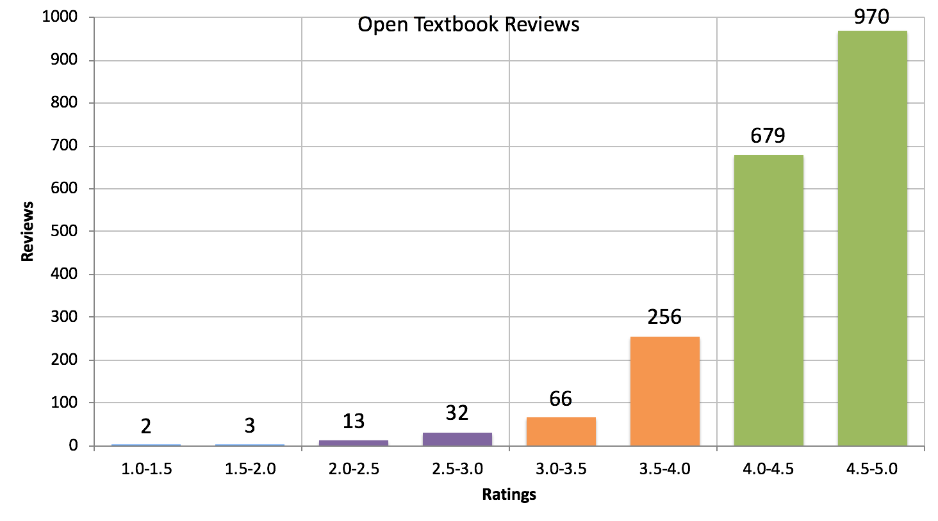
Notes:
Remember, OTN focuses on HONEST reviews, not seeking “good” reviews. Even if a text doesn’t live up to expectations, and honest review will tell faculty where things can be improved… or possibly… remixed or authored.

Slide 59
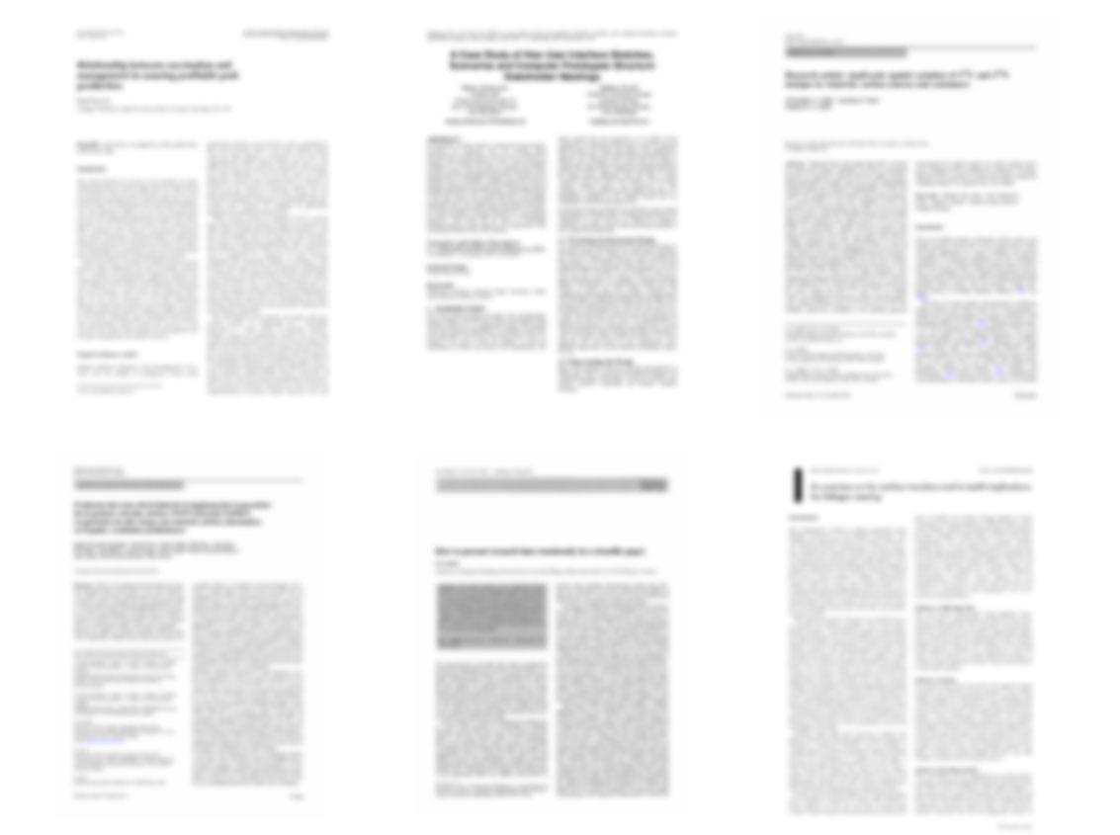
13 Peer Reviewed Studies of Efficacy
http://openedgroup.org/
Notes:
Across 13 academic studies that attempted to measure results pertaining to student learning (higher ed: 15784 treatment, 99,692 control, k12: 1805 treatment 2439 control) none showed results in which students who utilized OER performed worse than their peers who used traditional textbooks.
Allen, G., Guzman-Alvarez, A., Molinaro, M., Larsen, D. (2015). Assessing the Impact and Efficacy of the Open-Access ChemWiki Textbook Project. Educause Learning Initiative Brief, January 2015. See also this newsletter. Bowen, W. G., Chingos, M. M., Lack, K. A., & Nygren, T. I. (2012). Interactive Learning Online at Public Universities: Evidence from Randomized Trials. Ithaka S+R. Bowen, W. G., Chingos, M. M., Lack, K. A., & Nygren, T. I. (2014). Interactive Learning Online at Public Universities: Evidence from a Six‐Campus Randomized Trial. Journal of Policy Analysis and Management, 33(1), 94-111. Feldstein, A., Martin, M., Hudson, A., Warren, K., Hilton, J., & Wiley, D. (2012). Open textbooks and increased student access and outcomes. European Journal of Open, Distance and E-Learning. Retrieved from http://www.eurodl.org/index.php?p=archives&year=2012&halfyear=2&article=533. Gil, P., Candelas, F., Jara, C., Garcia, G., Torres, F (2013). Web-based OERs in Computer Networks. International Journal of Engineering Education, 29(6), 1537-1550. (OA preprint) Hilton, J., Gaudet, D., Clark, P., Robinson, J., & Wiley, D. (2013). The adoption of open educational resources by one community college math department. The International Review of Research in Open and Distance Learning, 14(4), 37–50. Hilton, J., & Laman, C. (2012). One college’s use of an open psychology textbook. Open Learning: The Journal of Open and Distance Learning, 27(3), 201–217. Retrieved from http://www.tandfonline.com/doi/abs/10.1080/02680513.2012.716657. (Open Repository Preprint). Lovett, M., Meyer, O., & Thille, C. (2008). The open learning initiative: Measuring the effectiveness of the OLI statistics course in accelerating student learning. Journal of Interactive Media in Education, 2008 (1). Pawlyshyn, Braddlee, Casper and Miller (2013). Adopting OER: A Case Study of Cross-Institutional Collaboration and Innovation. Educause Review. Robinson, T.J. (2015). Open Textbooks: The Effects of Open Educational Resource Adoption on Measures of Post-secondary Student Success (Doctoral dissertation). Robinson T. J., Fischer, L., Wiley, D. A., & Hilton, J. (2014). The impact of open textbooks on secondary science learning outcomes. Educational Researcher, 43(7): 341-351. Wiley, D., Hilton, J. Ellington, S., and Hall, T. (2012). “A preliminary examination of the cost savings and learning impacts of using open textbooks in middle and high school science classes.” International Review of Research in Open and Distance Learning. 13 (3), pp. 261-276.
This also includes Fischer et al (2015), Wiley et al. (EPAA) (2016), and Hilton et al. (IRRODL) (in press)

Slide 60
119,720 Students
http://openedgroup.org/
Notes:
Across 13 academic studies that attempted to measure results pertaining to student learning (higher ed: 15784 treatment, 99,692 control, k12: 1805 treatment 2439 control) none showed results in which students who utilized OER performed worse than their peers who used traditional textbooks.
Allen, G., Guzman-Alvarez, A., Molinaro, M., Larsen, D. (2015). Assessing the Impact and Efficacy of the Open-Access ChemWiki Textbook Project. Educause Learning Initiative Brief, January 2015. See also this newsletter. Bowen, W. G., Chingos, M. M., Lack, K. A., & Nygren, T. I. (2012). Interactive Learning Online at Public Universities: Evidence from Randomized Trials. Ithaka S+R. Bowen, W. G., Chingos, M. M., Lack, K. A., & Nygren, T. I. (2014). Interactive Learning Online at Public Universities: Evidence from a Six‐Campus Randomized Trial. Journal of Policy Analysis and Management, 33(1), 94-111. Feldstein, A., Martin, M., Hudson, A., Warren, K., Hilton, J., & Wiley, D. (2012). Open textbooks and increased student access and outcomes. European Journal of Open, Distance and E-Learning. Retrieved from http://www.eurodl.org/index.php?p=archives&year=2012&halfyear=2&article=533. Gil, P., Candelas, F., Jara, C., Garcia, G., Torres, F (2013). Web-based OERs in Computer Networks. International Journal of Engineering Education, 29(6), 1537-1550. (OA preprint) Hilton, J., Gaudet, D., Clark, P., Robinson, J., & Wiley, D. (2013). The adoption of open educational resources by one community college math department. The International Review of Research in Open and Distance Learning, 14(4), 37–50. Hilton, J., & Laman, C. (2012). One college’s use of an open psychology textbook. Open Learning: The Journal of Open and Distance Learning, 27(3), 201–217. Retrieved from http://www.tandfonline.com/doi/abs/10.1080/02680513.2012.716657. (Open Repository Preprint). Lovett, M., Meyer, O., & Thille, C. (2008). The open learning initiative: Measuring the effectiveness of the OLI statistics course in accelerating student learning. Journal of Interactive Media in Education, 2008 (1). Pawlyshyn, Braddlee, Casper and Miller (2013). Adopting OER: A Case Study of Cross-Institutional Collaboration and Innovation. Educause Review. Robinson, T.J. (2015). Open Textbooks: The Effects of Open Educational Resource Adoption on Measures of Post-secondary Student Success (Doctoral dissertation). Robinson T. J., Fischer, L., Wiley, D. A., & Hilton, J. (2014). The impact of open textbooks on secondary science learning outcomes. Educational Researcher, 43(7): 341-351. Wiley, D., Hilton, J. Ellington, S., and Hall, T. (2012). “A preliminary examination of the cost savings and learning impacts of using open textbooks in middle and high school science classes.” International Review of Research in Open and Distance Learning. 13 (3), pp. 261-276.
This also includes Fischer et al (2015), Wiley et al. (EPAA) (2016), and Hilton et al. (IRRODL) (in press)

Slide 61
95% Same or Better Outcomes
http://openedgroup.org/
Notes:
Across 13 academic studies that attempted to measure results pertaining to student learning (higher ed: 15784 treatment, 99,692 control, k12: 1805 treatment 2439 control) none showed results in which students who utilized OER performed worse than their peers who used traditional textbooks.
Allen, G., Guzman-Alvarez, A., Molinaro, M., Larsen, D. (2015). Assessing the Impact and Efficacy of the Open-Access ChemWiki Textbook Project. Educause Learning Initiative Brief, January 2015. See also this newsletter. Bowen, W. G., Chingos, M. M., Lack, K. A., & Nygren, T. I. (2012). Interactive Learning Online at Public Universities: Evidence from Randomized Trials. Ithaka S+R. Bowen, W. G., Chingos, M. M., Lack, K. A., & Nygren, T. I. (2014). Interactive Learning Online at Public Universities: Evidence from a Six‐Campus Randomized Trial. Journal of Policy Analysis and Management, 33(1), 94-111. Feldstein, A., Martin, M., Hudson, A., Warren, K., Hilton, J., & Wiley, D. (2012). Open textbooks and increased student access and outcomes. European Journal of Open, Distance and E-Learning. Retrieved from http://www.eurodl.org/index.php?p=archives&year=2012&halfyear=2&article=533. Gil, P., Candelas, F., Jara, C., Garcia, G., Torres, F (2013). Web-based OERs in Computer Networks. International Journal of Engineering Education, 29(6), 1537-1550. (OA preprint) Hilton, J., Gaudet, D., Clark, P., Robinson, J., & Wiley, D. (2013). The adoption of open educational resources by one community college math department. The International Review of Research in Open and Distance Learning, 14(4), 37–50. Hilton, J., & Laman, C. (2012). One college’s use of an open psychology textbook. Open Learning: The Journal of Open and Distance Learning, 27(3), 201–217. Retrieved from http://www.tandfonline.com/doi/abs/10.1080/02680513.2012.716657. (Open Repository Preprint). Lovett, M., Meyer, O., & Thille, C. (2008). The open learning initiative: Measuring the effectiveness of the OLI statistics course in accelerating student learning. Journal of Interactive Media in Education, 2008 (1). Pawlyshyn, Braddlee, Casper and Miller (2013). Adopting OER: A Case Study of Cross-Institutional Collaboration and Innovation. Educause Review. Robinson, T.J. (2015). Open Textbooks: The Effects of Open Educational Resource Adoption on Measures of Post-secondary Student Success (Doctoral dissertation). Robinson T. J., Fischer, L., Wiley, D. A., & Hilton, J. (2014). The impact of open textbooks on secondary science learning outcomes. Educational Researcher, 43(7): 341-351. Wiley, D., Hilton, J. Ellington, S., and Hall, T. (2012). “A preliminary examination of the cost savings and learning impacts of using open textbooks in middle and high school science classes.” International Review of Research in Open and Distance Learning. 13 (3), pp. 261-276.
This also includes Fischer et al (2015), Wiley et al. (EPAA) (2016), and Hilton et al. (IRRODL) (in press)

Slide 62
University of Georgia
Change from non-OER to OER
Δ Grade
Δ DFW
Non-Pell eligible students
+7.4%
-2.05%
Pell eligible students
+12.3%
-4.43%
All Students
+8.6%
-2.68%
The Impact of Open Educational Resources on Various Student Success Metrics
Notes:
Colvard, N., Watson, C., Park, H. (2018, July) The Impact of Open Educational Resources on Various Student Success Metrics. Retrieved from http://www.isetl.org/ijtlhe/pdf/IJTLHE3386.pdf
This article reports the results of a large-scale study (21,822 students) regarding the impact of course-level faculty adoption of Open Educational Resources (OER).

Slide 63
Drop Rate After Three Years
First Generation College Students
Parents Had Earned a Degree
33%
14%

Slide 64
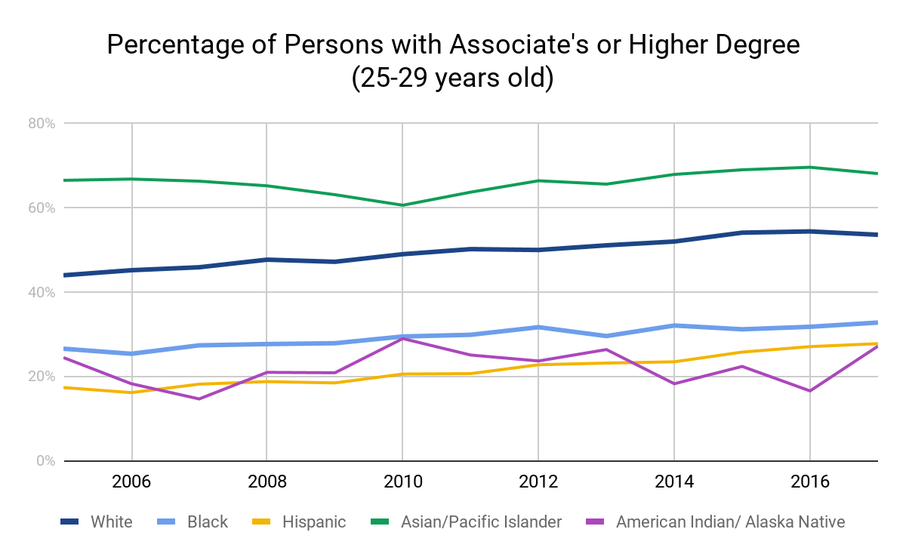
https://nces.ed.gov/programs/digest/d17/tables/dt17_104.20.asp

Slide 65
“…higher education shall be equally accessible to all”
Notes:
Not that many people know that United Nations’ Universal Declaration of Human Rights actually has language embedded within it concerning the importance of equal access to higher education (A26).
You might think of those people around the world. But no we are also talking about here in this country, where people who do not have equal access to higher ed.
And we are talking about an issue that is much broader than just textbooks.
I am very pleased to be here and to have a chance to speak with you about issues that I think concern us all. When I think about the value and goals of higher education, I see a vehicle to unleash human potential, to help our students become both knowledgeable & skillful, to become good global and good local citizens. I see a vehicle that has the potential to deliver us from social inequality. However, I also see that far too often higher education is structured in a way that only serves to reinforce social inequality.

Slide 66
What can we do?
Notes:
This is what they can do…

Slide 67
What can we do?
Take a look!
Write a review!
Adopt if a book meets the needs of you and your students
Raise awareness - talk with colleagues in your program and department
Notes:
This is what they can do…

Slide 68
Writing a Review
Is there is a textbook in the Open Textbook Library that fits your class and/or expertise?
Incentive will be paid for:
attending this workshop, and
reviewing a textbook in the Open Textbook Library
Notes:
To make it clear that they are eligible for the stipend only if they do both of these things. They can put a check next to #1…

Slide 69
Writing a Review
You will receive an email with a link to the online review form.
Complete a concise review by March 20, 2019.
The review will be posted on the Open Textbook Library under an open license.
Incentive will be paid.
Notes:
Here’s the review process. The due date – typically about 6 weeks after the workshop - should be discussed with your hosts before the workshop. Ask the faculty if the due date works for them.
Note that the review will have it’s own open license so we can share their wisdom with other open textbook projects. Note that if you over-emphasize this, some people could get cold feet. Tell them that it’s not a big deal. ☺

Slide 70
Open Textbook Library: open.umn.edu
Jonathan Lashley jonathanlashley@boisestate.edu @lashleyed Slides: http://slideshare.net/djernst
By David Ernst. This work is licensed under the Creative Commons Attribution 4.0 International License.

